Slide 1
Parallel Programming Chapter 1 Introduction to Parallel Architectures Johnnie Baker Spring 2011

Slide 2
Acknowledgements for material used in creating these slides
Mary Hall, CS4961 Parallel Programming, University of Utah.
Lawrence Snyder, CSE524 Parallel Programming, University of Washington
Chapter 1 of Course Text: Lin & Snyder, Principles of Parallel Programming.

Slide 3

Course Basic Details
Time & Location: MWF 2:15-3:05
Course Website:
http://www.cs.kent.edu/~jbaker/ParallelProg-Sp11/
Instructor : Johnnie Baker
jbaker@cs.kent.edu
http://www.cs.kent.edu/~jbaker
Office Hours: 12:15-1:30 MWF in my office –MSB160
May have to change
Textbook:
“Principles of Parallel Programming,”
Also, readings and/or notes provided for languages and some topics

Slide 4
Course Basic Details (cont)
Prerequistes: Data Structures
Algorithms and Operating Systems useful but not required
Topics Covered in Course
Will cover topics from most topics in textbook
May add information on programming languages used, probably MPI, OpenMP, CUDA
May add some information on parallel algorithms
Course Requirements – may be adjusted depending on total amount of homework and programming assignments.
Midterm Exam 25%
Homework 25%
Programming Projects 25%
Final Exam 25%

Slide 5
Course Logistics
Class webpage will be headquarters for all slides, reading supplements, and assignments
Take lecture notes – as slides will be online sometime after the lecture
Informal class: Ask questions immediately

Slide 6
Why Study Parallelism
Currently, sequential processing is plenty fast for most of our daily computing uses
Some Advantages of Parallel include
The extra power from parallel computers is enabling in science, engineering, business, etc.
Multicore chips present new opportunities
Deep intellectual challenges for CS – models, programming languages, algorithms, etc.

Slide 7
Why is this Course Important?
Multi-core and many-core era is here to stay
Why? Technology Trends
Many programmers will be developing parallel software
But still not everyone is trained in parallel programming
Learn how to put all these vast machine resources to the best use!
Useful for
Joining the work force
Graduate school
Our focus
Teach core concepts
Use common programming models
Discuss broader spectrum of parallel computing

Slide 8
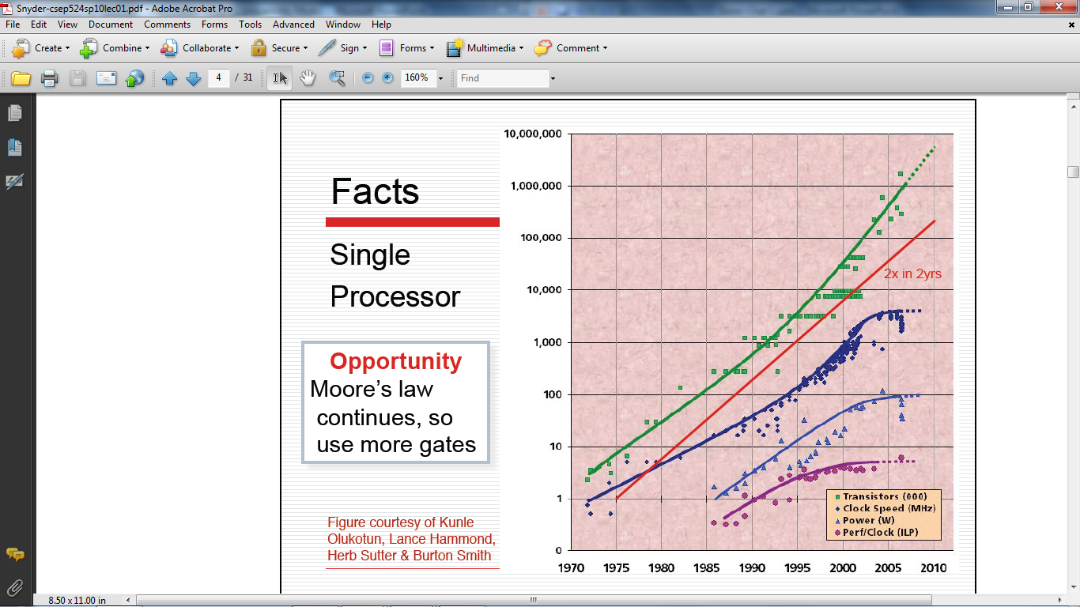
Clock speed flattening sharply

Slide 9
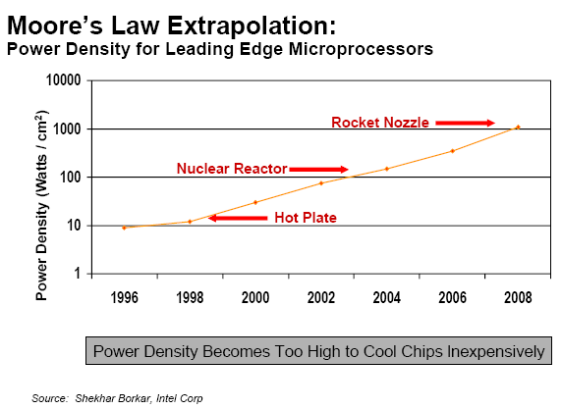
Technology Trends: Power Density Limits Serial Performance

Slide 10
What to do with all these transistors?
The Multi-Core Paradigm Shift
Key ideas:
Movement away from increasingly complex processor design and faster clocks
Replicated functionality (i.e., parallel) is simpler to design
Resources more efficiently utilized
Huge power management advantages
All Computers are Parallel Computers.

Slide 11
Scientific Simulation: The Third Pillar of Science
Traditional scientific and engineering paradigm:
Do theory or paper design.
Perform experiments or build system.
Limitations:
Too difficult -- build large wind tunnels.
Too expensive -- build a throw-away passenger jet.
Too slow -- wait for climate or galactic evolution.
Too dangerous -- weapons, drug design, climate experimentation.
Computational science paradigm:
Use high performance computer systems to simulate the phenomenon
Base on known physical laws and efficient numerical methods.

Slide 12
The quest for increasingly more powerful machines
Scientific simulation will continue to push on system requirements:
To increase the precision of the result
To get to an answer sooner (e.g., climate modeling, disaster modeling)
The U.S. will continue to acquire systems of increasing scale
For the above reasons
And to maintain competitiveness

Slide 13
A Similar Phenomenon in Commodity Systems
More capabilities in software
Integration across software
Faster response
More realistic graphics
…

Slide 14
The fastest computer in the world today
Jaguar (Cray XT5)
Oak Ridge National
Laboratory
~37,000 processor chips
(224,162 cores)
AMD 6-core Opterons
1.759 Petaflop/second
One quadrillion operations/s
1 x 10¹⁶
What is its name?
Where is it located?
How many processors does it have?
What kind of processors?
How fast is it?
See http://www.top500.org

Slide 15
The SECOND fastest computer in the world today
RoadRunner
Los Alamos National
Laboratory
~19,000 processor chips
(~129,600 “processors”)
AMD Opterons and
IBM Cell/BE (in Playstations)
1.105 Petaflop/second
One quadrilion operations/s
1 x 10¹⁶
What is its name?
Where is it located?
How many processors does it have?
What kind of processors?
How fast is it?
See http://www.top500.org

Slide 16
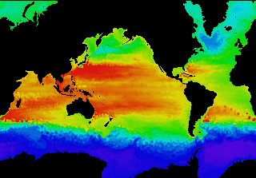
Example: Global Climate Modeling Problem
Problem is to compute:
f(latitude, longitude, elevation, time) →
temperature, pressure, humidity, wind velocity
Approach:
Discretize the domain, e.g., a measurement point every 10 km
Devise an algorithm to predict weather at time t+δt given t
Uses:
Predict major events, e.g., El Nino
Use in setting air emissions standards
Source: http://www.epm.ornl.gov/chammp/chammp.html

Slide 17
High Resolution Climate Modeling on NERSC-3 – P. Duffy, et al., LLNL

Slide 18
Some Characteristics of Scientific Simulation
Discretize physical or conceptual space into a grid
Simpler if regular, may be more representative if adaptive
Perform local computations on grid
Given yesterday’s temperature and weather pattern, what is today’s expected temperature?
Communicate partial results between grids
Contribute local weather result to understand global weather pattern.
Repeat for a set of time steps
Possibly perform other calculations with results
Given weather model, what area should evacuate for a hurricane?

Slide 19
Example of Discretizing a Domain
One processor
computes this part
Another processor
computes this part in
parallel
Processors in adjacent blocks in the grid communicate their result.

Slide 20
Parallel Programming Complexity
An Analogy to Preparing Thanksgiving Dinner
Enough parallelism? (Amdahl’s Law)
Suppose you want to just serve turkey
Granularity
How frequently must each assistant report to the chef
After each stroke of a knife? Each step of a recipe? Each dish completed?
Locality
Grab the spices one at a time? Or collect ones that are needed prior to starting a dish?
Load balance
Each assistant gets a dish? Preparing stuffing vs. cooking green beans?
Coordination and Synchronization
Person chopping onions for stuffing can also supply green beans
Start pie after turkey is out of the oven
All of these things makes parallel programming even harder than sequential programming.

Slide 21
Parallel and Distributed Computing
Parallel computing (processing):
the use of two or more processors (computers), usually within a single system, working simultaneously to solve a single problem.
Distributed computing (processing):
any computing that involves multiple computers remote from each other that each have a role in a computation problem or information processing.
Parallel programming:
the human process of developing programs that express what computations should be executed in parallel.

Slide 22
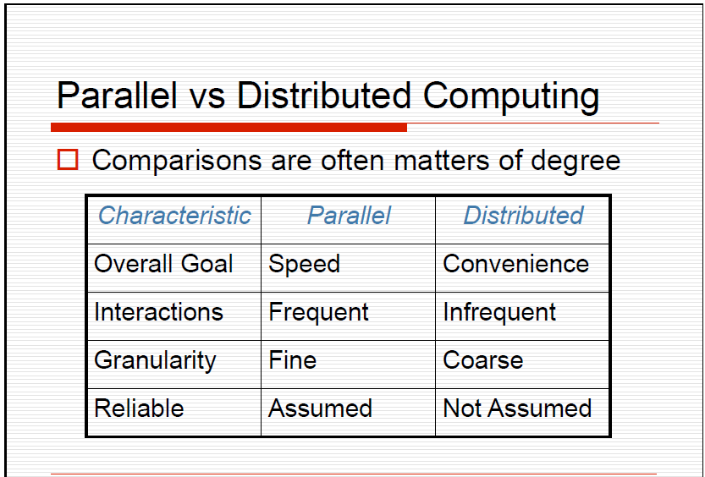

Slide 23
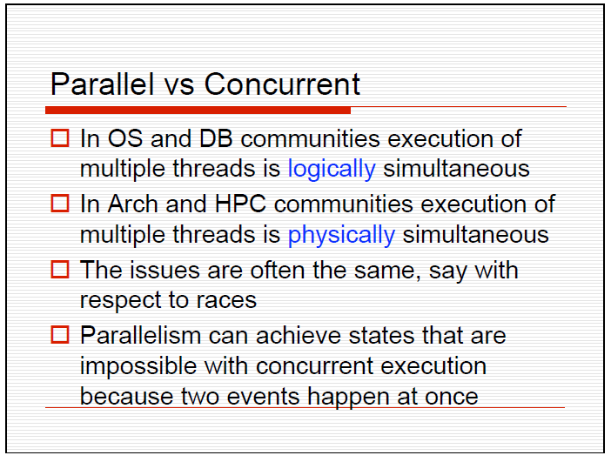

Slide 24
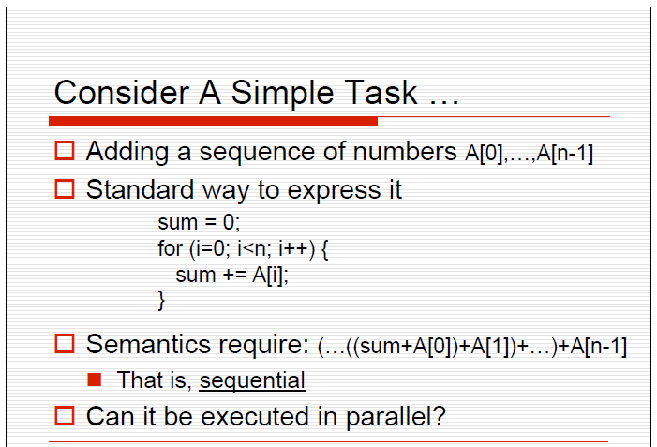

Slide 25
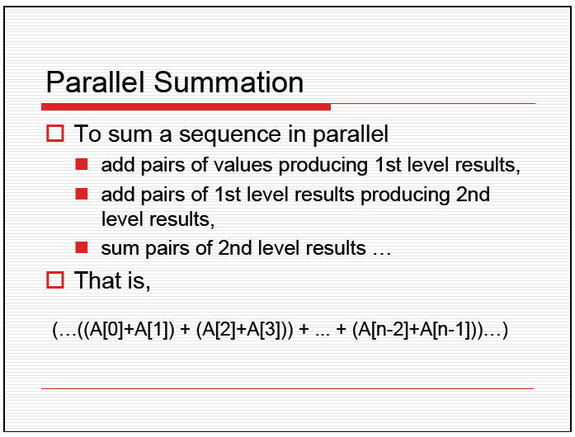

Slide 26
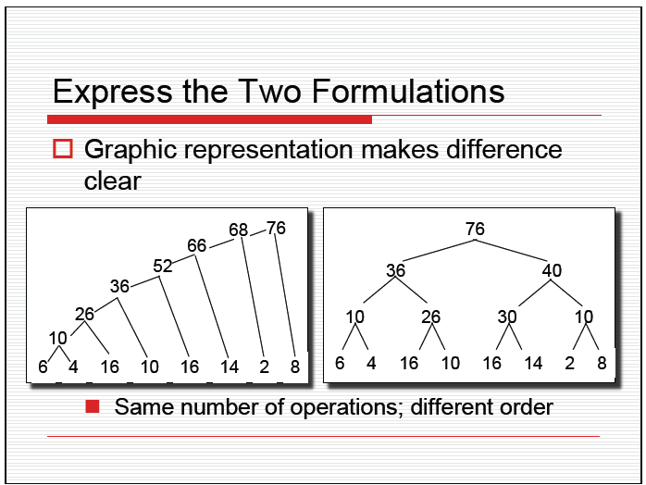

Slide 27
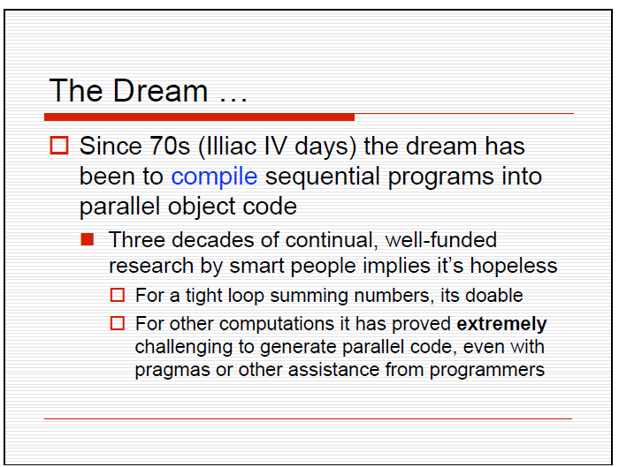

Slide 28
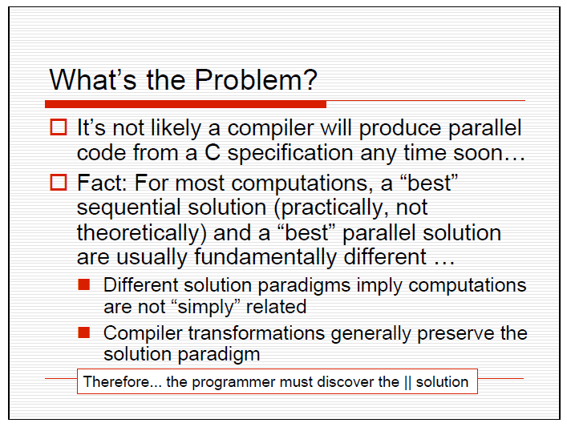

Slide 29
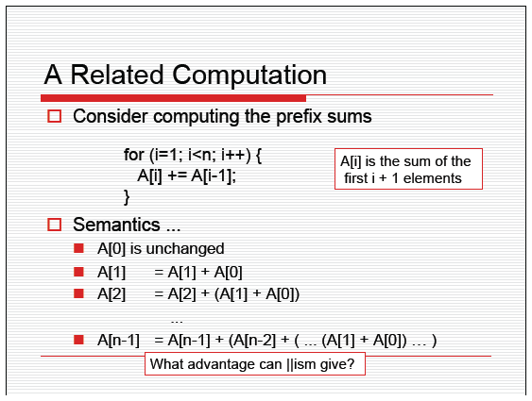

Slide 30
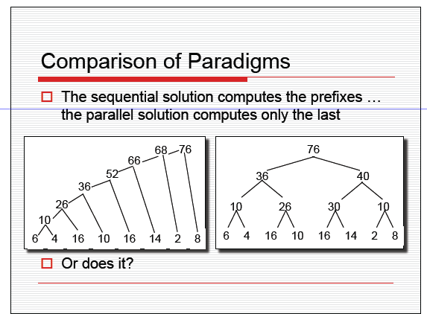

Slide 31
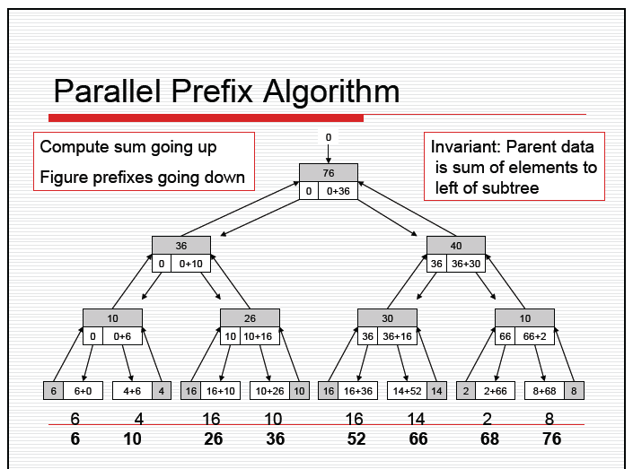

Slide 32
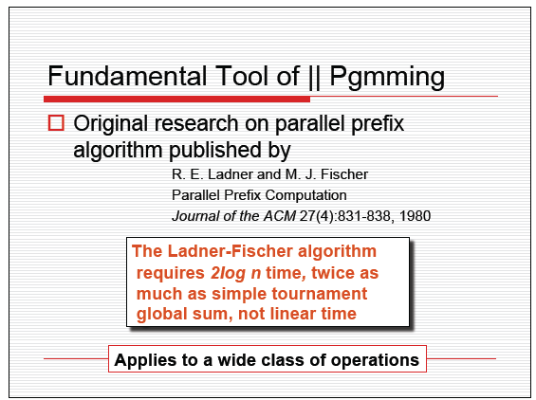

Slide 33
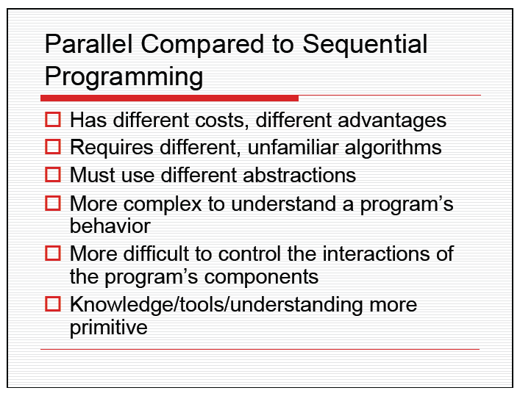

Slide 34
Is it really harder to “think” in parallel?
Some would argue it is more natural to think in parallel…
… and many examples exist in daily life
House construction -- parallel tasks, wiring and plumbing performed at once (independence), but framing must precede wiring (dependence)
Similarly, developing large software systems
Assembly line manufacture - pipelining, many instances in process at once
Call center - independent calls executed simultaneously (data parallel)
“Multi-tasking” – all sorts of variations

Slide 35
Finding Enough Parallelism
Suppose only part of an application seems parallel
Amdahl’s law
let s be the fraction of work done sequentially, so (1-s) is fraction parallelizable
P = number of processors
Speedup(P) = Time(1)/Time(P)
<= 1/(s + (1-s)/P)
<= 1/s
Even if the parallel part speeds up perfectly performance is limited by the sequential part

Slide 36
Overhead of Parallelism
Given enough parallel work, this is the biggest barrier to getting desired speedup
Parallelism overheads include:
cost of starting a thread or process
cost of communicating shared data
cost of synchronizing
extra (redundant) computation
Each of these can be in the range of milliseconds (=millions of flops) on some systems
Tradeoff: Algorithm needs sufficiently large units of work to run fast in parallel (I.e. large granularity), but not so large that there is not enough parallel work

Slide 37
Load Imbalance
Load imbalance is the time that some processors in the system are idle due to
insufficient parallelism (during that phase)
unequal size tasks
Examples of the latter
adapting to “interesting parts of a domain”
tree-structured computations
fundamentally unstructured problems
Algorithm needs to balance load

Slide 38
Summary of Preceding Slides
Solving the “Parallel Programming Problem”
Key technical challenge facing today’s computing industry, government agencies and scientists
Scientific simulation discretizes some space into a grid
Perform local computations on grid
Communicate partial results between grids
Repeat for a set of time steps
Possibly perform other calculations with results
Commodity parallel programming can draw from this history and move forward in a new direction
Writing fast parallel programs is difficult
Amdahl’s Law ➔Must parallelize most of computation
Data Locality
Communication and Synchronization
Load Imbalance

Slide 39
Reasoning about a Parallel Algorithm
Ignore architectural details for now
Assume we are starting with a sequential algorithm and trying to modify it to execute in parallel
Not always the best strategy, as sometimes the best parallel algorithms are NOTHING like their sequential counterparts
But useful since you are accustomed to sequential algorithms

Slide 40
Reasoning about a parallel algorithm, cont.
Computation Decomposition
How to divide the sequential computation among parallel threads/processors/computations?
Aside: Also, Data Partitioning (ignore today)
Preserving Dependences
Keeping the data values consistent with respect to the sequential execution.
Overhead
We’ll talk about some different kinds of overhead

Slide 41
Race Condition or Data Dependence
A race condition exists when the result of an execution depends on the timing of two or more events.
A data dependence is an ordering on a pair of memory operations that must be preserved to maintain correctness.

Slide 42
A Simple Example
Count the 3s in array[] of length values
Definitional solution … Sequential program
count = 0;
for (i=0; i<length; i++) {
if (array[i] == 3)
count += 1;
}
Can we rewrite this to a parallel code?

Slide 43
Computation Partitioning
Block decomposition: Partition original loop into separate “blocks” of loop iterations.
Each “block” is assigned to an independent “thread” in t0, t1, t2, t3 for t=4 threads
Length = 16 in this example
{
{
{
{
2
3
07
2
3
3
1
02
09
1
3
2
2
3
1
0
t0
t1
t2
t3
int block_length_per_thread = length/t;
int start = id * block_length_per_thread;
for (i=start; i<start+block_length_per_thread; i++) {
if (array[i] == 3)
count += 1;
}
Correct?
Preserve
Dependences?

Slide 44
Data Race on Count Variable
Two threads may interfere on memory writes
{
{
{
{
2
3
07
2
3
3
1
02
09
1
3
2
2
3
1
0
t0
t1
t2
t3
Thread 1
Thread 3
load count
increment count
store count
count = 0
load count
increment count
store count
count = 1
count = 2
count = 1
store<count,1>
store<count,2>

Slide 45
What Happened?
Dependence on count across iterations/threads
But reordering ok since operations on count are associative
Load/increment/store must be done atomically to preserve sequential meaning
Definitions:
Atomicity: a set of operations is atomic if either they all execute or none executes. Thus, there is no way to see the results of a partial execution.
Mutual exclusion: at most one thread can execute the code at any time

Slide 46
Try 2: Adding Locks
Insert mutual exclusion (mutex) so that only one thread at a time is loading/incrementing/storing count atomically
int block_length_per_thread = length/t;
mutex m;
int start = id * block_length_per_thread;
for (i=start; i<start+block_length_per_thread; i++) {
if (array[i] == 3) {
mutex_lock(m);
count += 1;
mutex_unlock(m);
}
}
Correct now. Done?

Slide 47
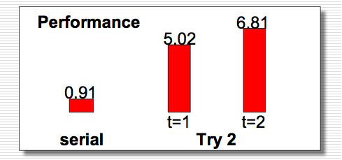
Performance Problems
Serialization at the mutex
Insufficient parallelism granularity
Impact of memory system

Slide 48
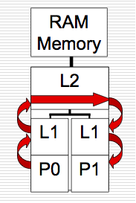
Lock Contention and Poor Granularity
To acquire lock, must go through at least a few levels of cache (locality)
Local copy in register not going to be correct
Not a lot of parallel work outside of acquiring/releasing lock

Slide 49
Try 3: Increase “Granularity”
Each thread operates on a private copy of count
Lock only to update global data from private copy
mutex m;
int block_length_per_thread = length/t;
int start = id * block_length_per_thread;
for (i=start; i<start+block_length_per_thread; i++) {
if (array[i] == 3)
private_count[id] += 1;
}
mutex_lock(m);
count += private_count[id];
mutex_unlock(m);

Slide 50
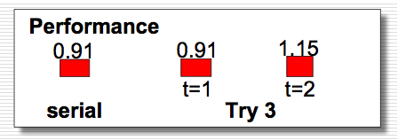
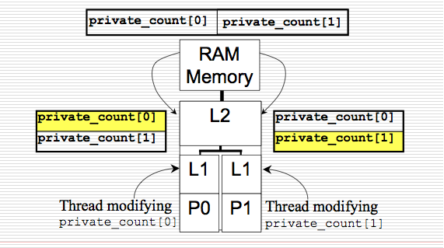
Much Better, But Not Better than Sequential
Subtle cache effects are limiting performance
Private variable ≠
Private cache line

Slide 51
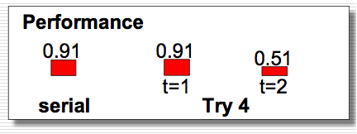
Try 4: Force Private Variables into Different Cache Lines
Simple way to do this?
See textbook for authors’ solution
Parallel speedup when <t = 2>:
time(1)/time(2) = 0.91/0.51
= 1.78 (close to number of processors!)

Slide 52
Discussion: Overheads
What were the overheads we saw with this example?
Extra code to determine portion of computation
Locking overhead: inherent cost plus contention
Cache effects: false sharing

Slide 53
Generalizing from this example
Interestingly, this code represents a common pattern in parallel algorithms
A reduction computation
From a large amount of input data, compute a smaller result that represents a reduction in the dimensionality of the input
In this case, a reduction from an array input to a scalar result (the count)
Reduction computations exhibit dependences that must be preserved
Looks like “result = result op …”
Operation op must be associative so that it is safe to reorder them
Aside: Floating point arithmetic is not truly associative, but usually ok to reorder

